Slide 1
WHY SOFTWARE TESTING

Slide 2
Software Testing
PROCESS TO IDENTIFY
CORRECTNESS,
COMPLETENESS,
QUALITY OF DEVELOPED SOFTWARE.
SET OF ACTIVITIES ARE CONDUCTED WITH AN INTENT OF FINDING ERRORS IN SOFTWARE, SO THAT A DEFECT FREE SOFTWARE CAN BE RELEASED TO THE CUSTOMER.
Verification of Application Under Test (AUT)
Notes:
It involves execution of software/system components using manual or automated tools to evaluate one or more properties of interest. The purpose of software testing is to identify errors, gaps or missing requirements in contrast to actual requirements.

Slide 3
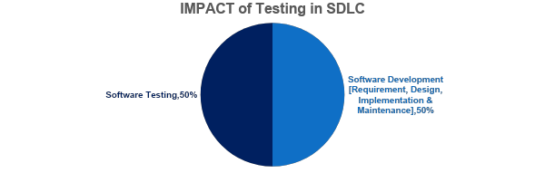
IMPORTANCE OF TESTING
ensures reliability, security and high performance which further results in time saving, cost effectiveness and customer satisfaction.

Slide 4
WHY SOFTWARE TESTING

Slide 5

AIRPLANE CLASH
APRIL, 1994
CHINA AIR BUS A300
AIRPLANE CRASH
DUE TO SOFTWARE FAILURE
264 PEOPLE DEAD

Slide 6
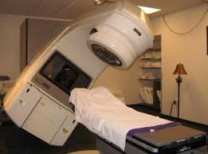
THERAC-25 RADIATION THERAPY FAILURE
1985
THERAC-25 RADIATION THERAPY
MALFUNCTION DUE TO SOFTWARE BUG
3 DEAD & 3 CRITICALLY INJURED

Slide 7

SATELLITE LAUNCH FAILURE
APRIL, 1999
MILITARY SATELLITE LAUNCH
SOFTWARE BUG
$1.2BILLION LOSS

Slide 8

BANK FUNDS MISTRANSFER
MAY, 1996
SOFTWARE BUG
823 CUSTOMERS OF US BANK
CREDITED WITH $920 MILLION

Slide 9
SOFTWARE BUGS CAN BE EXPENSIVE
& SOME TIMES DANGEROUS TO HUMAN LIFE

Slide 10
TESTING IS NOT EASY TOO…

Slide 11
TESTING IS NOT EASY TOO…
NUMBER OF TEST CASES TO BE WRITTEN TO VALIDATE THE PASSWORD
CONSTRAINTS:
CHARACTERS LENGTH – 7
1ST CHARACTER – NUMERIC VALUE
2ND – 7TH CHARACTER – ALPHA NUMERIC

Slide 12
TESTING IS NOT EASY TOO… (CONTD.,)
1ST CHARACTER – 10 WAYS
( DIGITS FROM 0-9 )
2ND – 7TH CHARACTER – 62 COMBINATIONS
(DIGITS 0-9, ALPHABETS: LOWER CASE a-z, UPPER CASE A-Z)

Slide 13
TESTING IS NOT EASY TOO… (CONTD.,)
TOTAL COMBINATIONS FOR ENTIRE PASSWORD
=> 10 * 62 * 62 * 62 * 62 * 62 * 62
=> 5,68,00,23,55,840 TESTCASES
IF APPROXIMATELY 10 SECONDS FOR EACH CASE
=> 18011 YEARS

Slide 14

REFERENCES

Slide 15
Top Software Testing Services Companies
1) Testlio
2) QA Wolf
3) TestMatick
4) A1QA
5) PFLB
6) iBeta Quality Assurance
7) Aspire Systems
8) Indium
9) TestingXperts
10) Abstracta

